Slide 1

BITCOIN Mining
By:
Priyanshu Kumar (20N31A05H8)
Mudavath Hanmanthu (20N31A05F7)
Raj Priyanshu (20N31A05H7)

Slide 2
introduction
AIM :
Bitcoin mining ensures that blocks of transactions are created and stacked in the right order in a way that can be traced and proven mathematically.
SCOPE :
Bitcoin mining fees will disappear when the Bitcoin supply reaches 21 million. After that, miners will likely earn income only from transaction processing fees rather than a combination of block rewards and transaction fees.

Slide 3
What is Bitcoin Mining?
Bitcoin mining refers to the process of digitally adding transaction records to the blockchain, which is a publicly distributed ledger holding the history of every bitcoin transaction. Mining is a record-keeping process executed through immense computing power.
There are three ways to acquire Bitcoin:
Purchase them on an exchange
Receive them in exchange for goods and services
Mine new Bitcoin
The process of discovering new Bitcoin is described as mining because it resembles the process of mining for any other resource. Like minerals.

Slide 4
Why Mine Bitcoin?
Bitcoin offers a disrupting technology in the blockchain. The currency itself is decentralized, allowing transactions to happen globally without government restrictions and delays. Miners of Bitcoin see value in the decentralization of cryptocurrency
The following are the important factors to Bitcoin mining profitability:
1. Computing hardware
Miners need to own the latest hardware to compete with the increasing requirements for successful mining. Equipment can become obsolete in a matter of years. They need mining-specific hardware, which can be costly. The latest ASIC mining rigs cost over $1,500 per computer.
2. Power costs
Power will be the main operating expense. Electricity is charged per kilowatt-hour (kWh). Profitability for mining can float from $0.03 – $0.08 per kWh. A shift in a few cents can make all the difference for mining profitability. It is imperative that a miner can use power at the lowest possible cost.
3. Bitcoin price
The price of Bitcoin is important in mining because miners receive a certain amount of Bitcoin when they correctly solve math problems

Slide 5
Software and hardware requirements
SOFTWARE REQUIREMENTS:
Operating System : Windows 10
VIDEO CARD: Nvidia GTX 460 or AMD analog.
DEDICATED VIDEO RAM: 1024 MB.
PIXEL SHADER: 5.0.
VERTEX SHADER: 5.0
HARDWARE REQUIREMENTS :
Ram : 4GB
Hard disk : 1GB
Processor : Intel I3, I5, I7

Slide 6
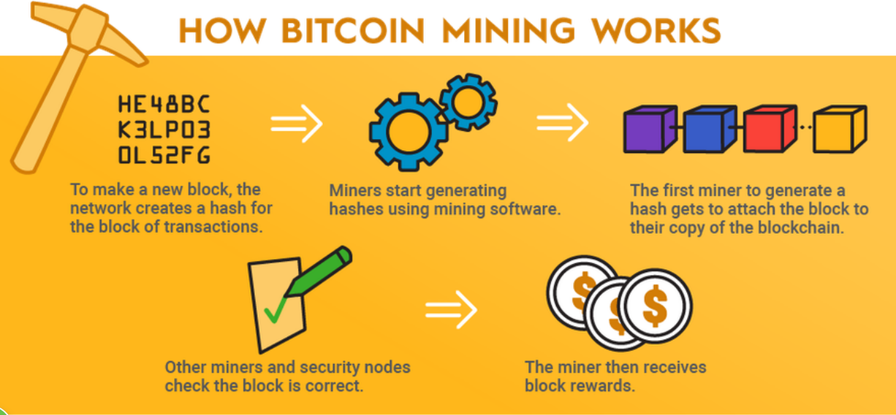

Slide 7
Bitcoin Mining with Python
The number below is a 64-bit hexadecimal number. Now, if you want to do Bitcoin Mining, you don’t have to mine the whole number. You will only need a few numbers.
So what Bitcoin miners do is use huge computer systems to guess the target hash value. Miners make such guesses by randomly generating as many nonces as possible. A nonce is just an abbreviation of the number which can only be used once.
Simply put, a nonce is a number that miners are guessing and when they guess the right number, they offer Bitcoin in exchange.
For the task of Bitcoin Mining with Python, we just need to guess the correct nonce and then generate a hash number with the first X numbers of zeros.

Slide 8
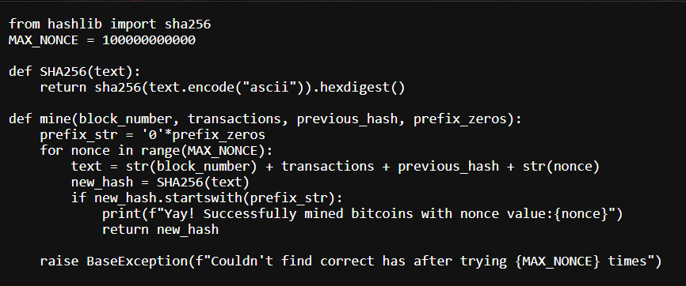
Code

Slide 9
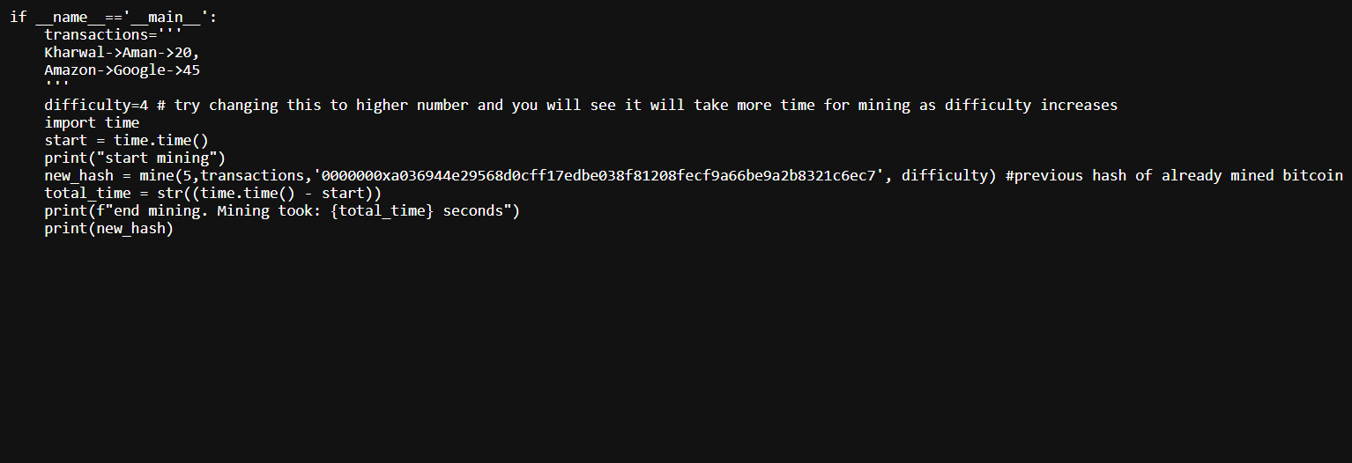

Slide 10
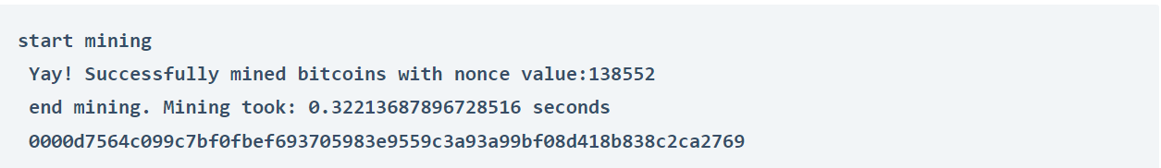
Output

Slide 11
Conclusion

